Slide 1
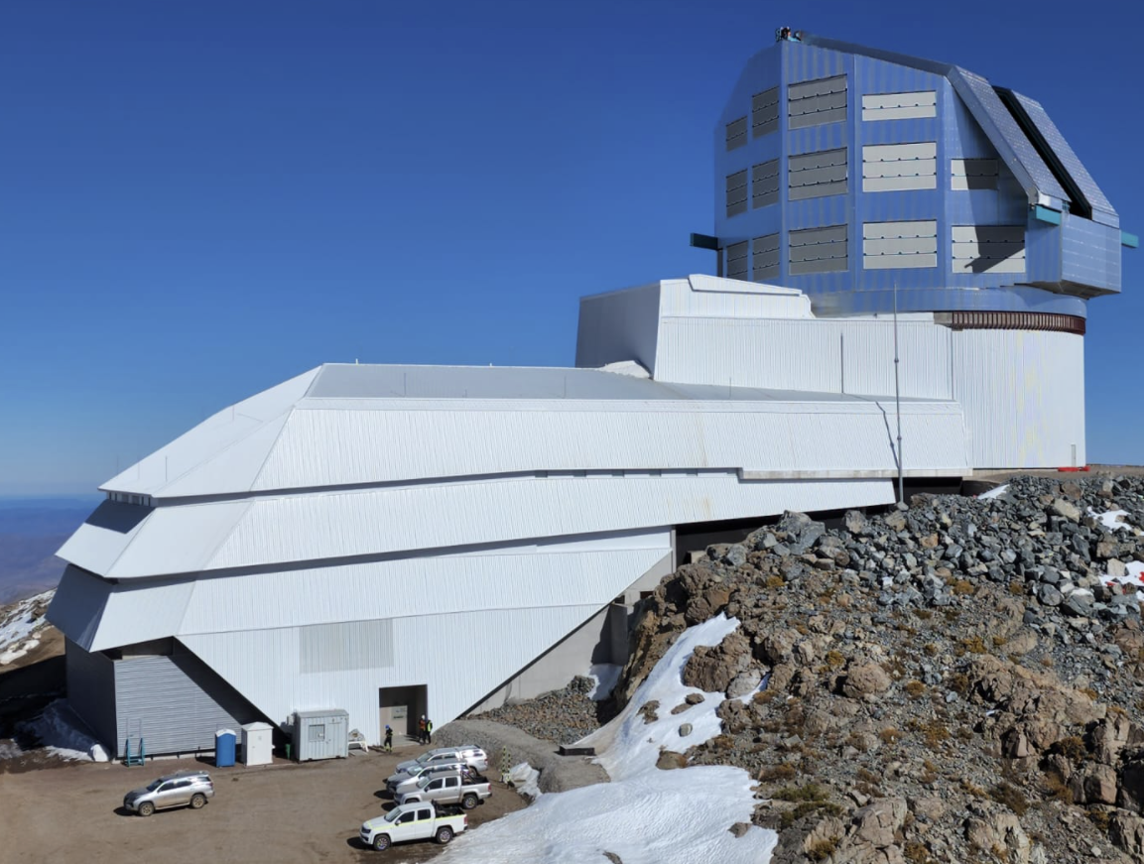

Estimating stellar distances
with LSST’s
broad-band photometry
Željko Ivezić, for the “PhotoD collaboration”
University of Washington
LINCC, Jan 19, 2023

Slide 2
PITCH
1) To maximize science output with 20 billions stars measured by LSST, we need to estimate their distances: go from 2D to 3D studies.
2) There will be hundreds, if not thousands, of papers enabled by this project/catalog: huge impact.
3) Astrophysics and statistics understood, prototype python code works – the next step is design and implementation of robust and fast code, with proper configuration and provenance management.

Slide 3
OUTLINE
1) The basics of stellar “photo-D” (in analogy with “photo-z”)
2) Where are we now?
3) What remains to be done – potential for LINCC

Slide 4
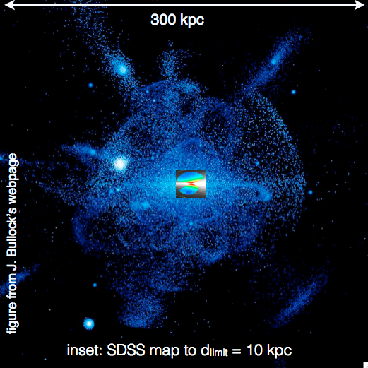
Milky Way science with coadded LSST data
One of the four LSST Science Themes:
The Milky Way structure
(stars as tracers of the
structure and evolution of
our Galaxy, interstellar
matter, the physics of stars)
SDSS example: Jurić et al. (2008, ApJ, 673, 864)
data-based map of stellar counts shown in the center
LSST:
100 kpc
50% sky
Turn-off stars
DES:
40 kpc
12% sky
To make such maps of the Milky Way with LSST, we need first to estimate distances to stars
(~20 billion stars in LSST)
SDSS:
10 kpc
25% sky

Slide 5
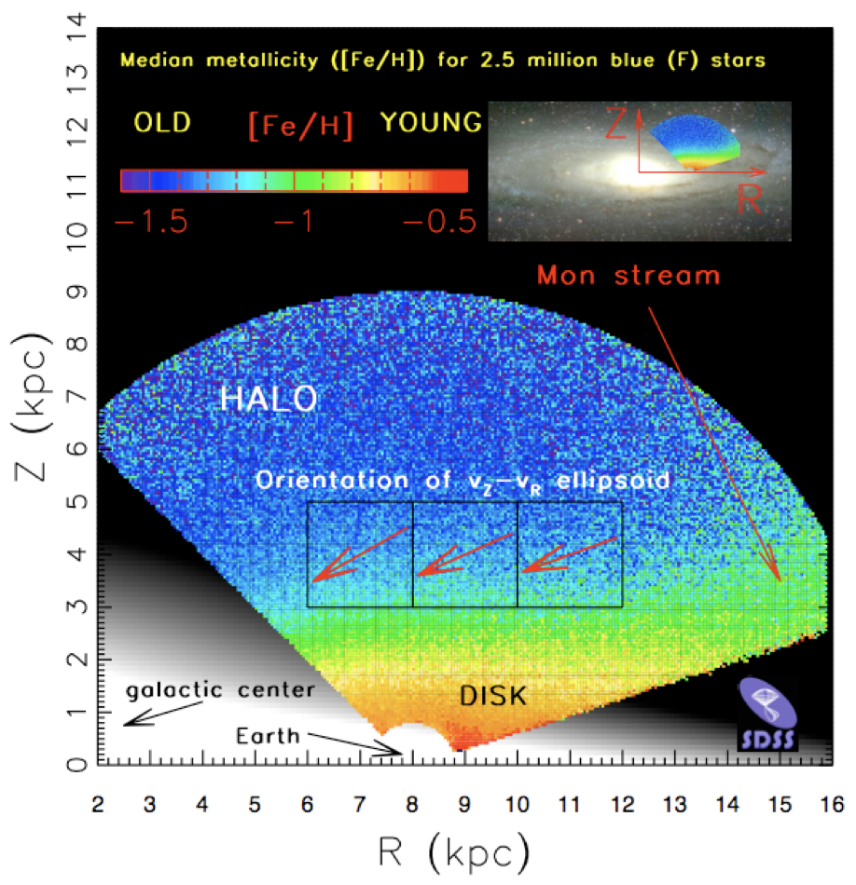
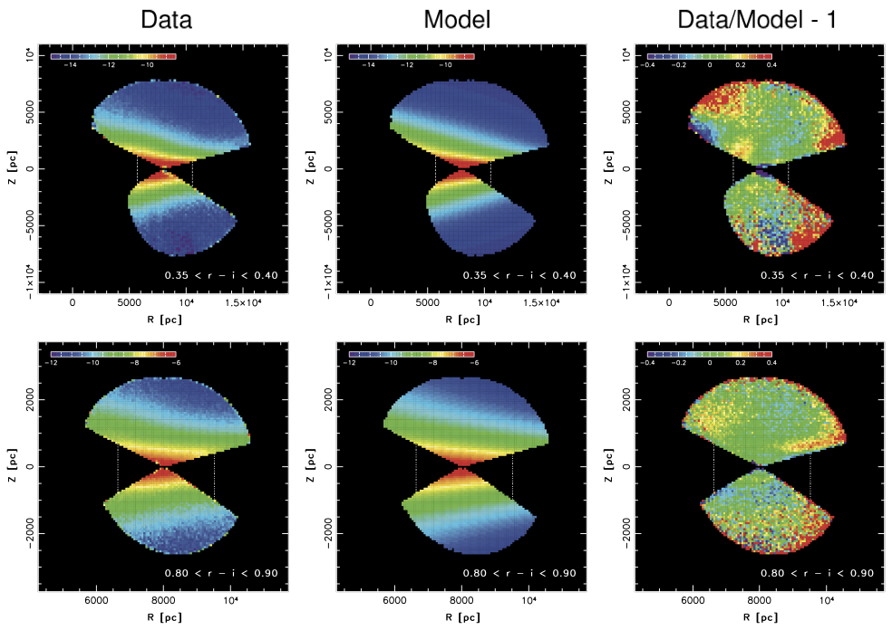
photo-D: science motivation
if we know stellar distances, we can study the Milky Way structure
Ivezic+ (2008, ApJ, 684, 287)
Juric+ (2008, ApJ, 673, 864)

Slide 6
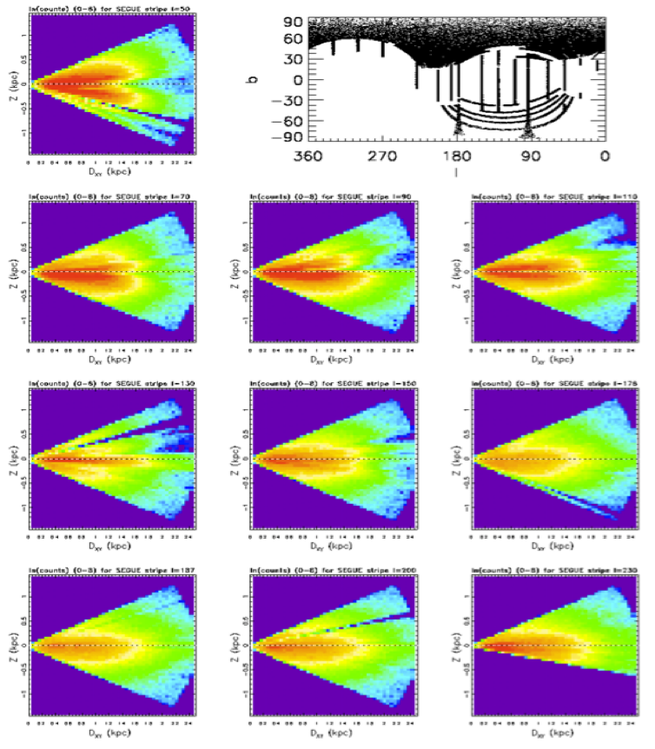
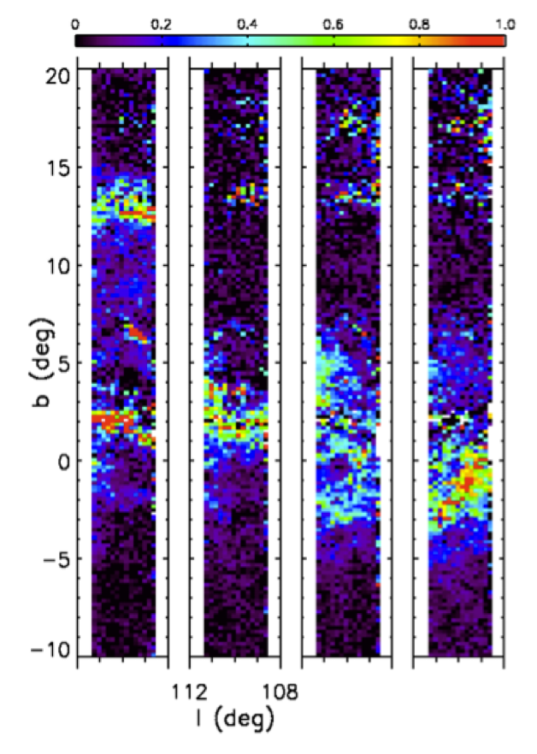
photo-D: science motivation
if we know stellar distances, we can study the Milky Way structure
furthermore, at low galactic latitudes, we can map dust (and its properties), too
left: differences in median A_{r} for D~ 1, 1.5, 2, 2.5 kpc
dust at b ~ 2º and b~13º is confined to D~1-1.5 kpc
dust at -3º < b < 0º is at D~2 kpc
Stellar counts
Dust tomography
Berry+ (2012, ApJ, 757, 166)

Slide 7
SDSS
gri
3.5’x3.5’
r~22.5
3 arcmin is 1/10 of the full Moon’s diameter
3 arcmin is 1/10 of the full Moon’s diameter

Slide 8
HSC
gri
3.5’x3.5’
r~27
LSST will deliver colors for about 20 billion stars
like LSST depth (but tiny area) area)
like LSST depth (but tiny area)
LSST will deliver 5 million such images

Slide 9
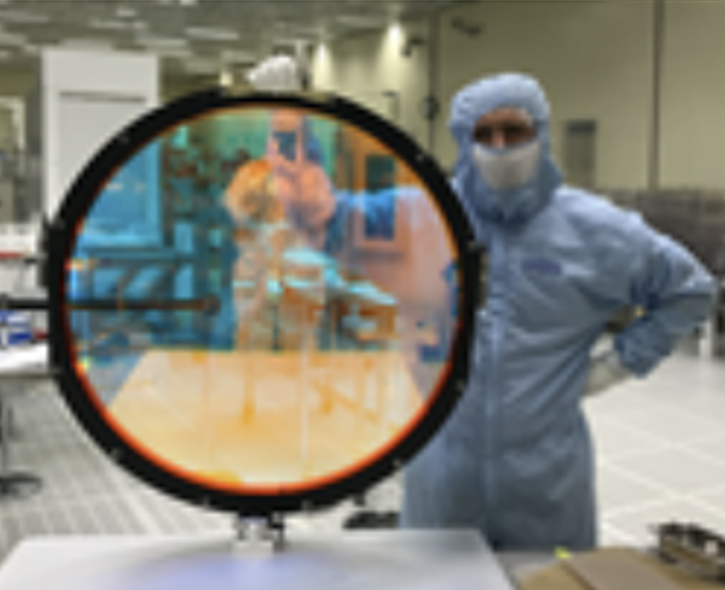
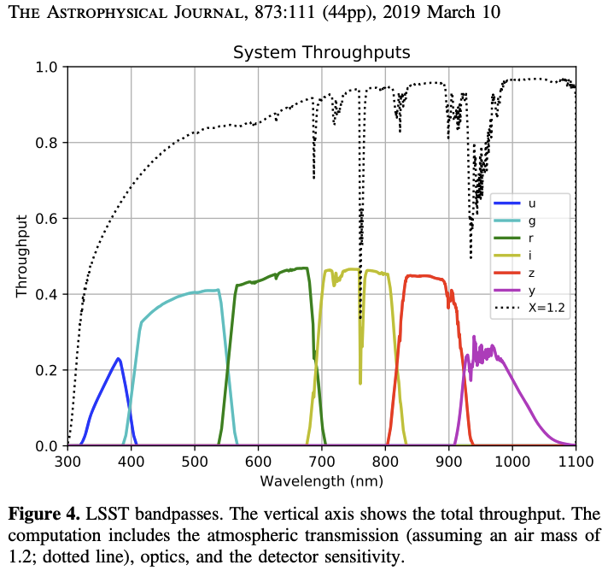
LSST filter complement: ugrizy
Per-band survey time allocations:
u: 8%, g:10%, r: 22%
i: 22%, z: 19%, y:19%
Optimized using photo-z for galaxies
but consistent with star-quasar separation and stellar [Fe/H] estimates.
Similar, but not identical, to SDSS.
20

Slide 10
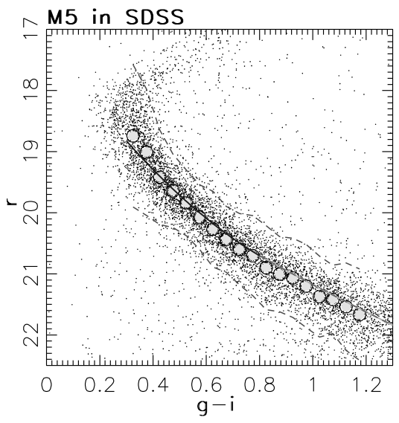
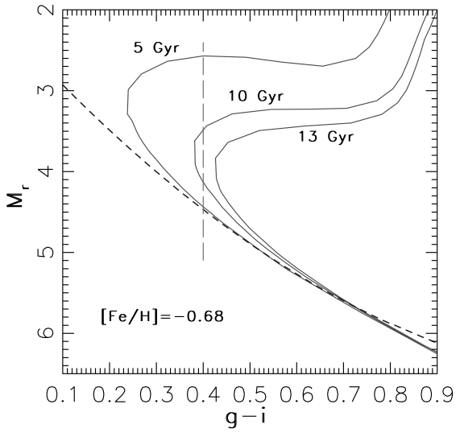
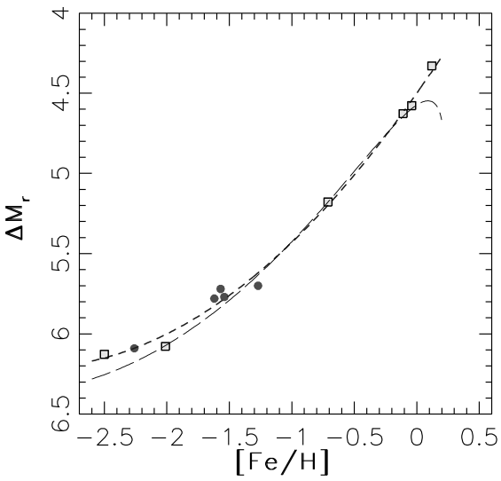
photo-D methodology: stellar astrophysics 0
Data include apparent magnitudes: one magnitude and many colors
Given apparent and absolute magnitudes (and perhaps extinction): Distance follows
Stellar colors determined by: T_{eff}, [Fe/H], log(g) – or alternatively: Mr, [Fe/H], age
different “populations” along an “isochrone”: MS, giants, WDs (binaries)
Given Mr, [Fe/H] and age, can “predict” colors
from theoretical or empirical isochrones, so
given observed colors, can place constraints
for Mr and [Fe/H] (and sometimes on age)
Colors can also constrain dust extinction
Distance from: r = Mr + Ar + 5*log(D)
where Mr and Ar constrained by colors
models
Used globular clusters to derive Mr as a function of metallicity [Fe/H] and (g-i)

Slide 11
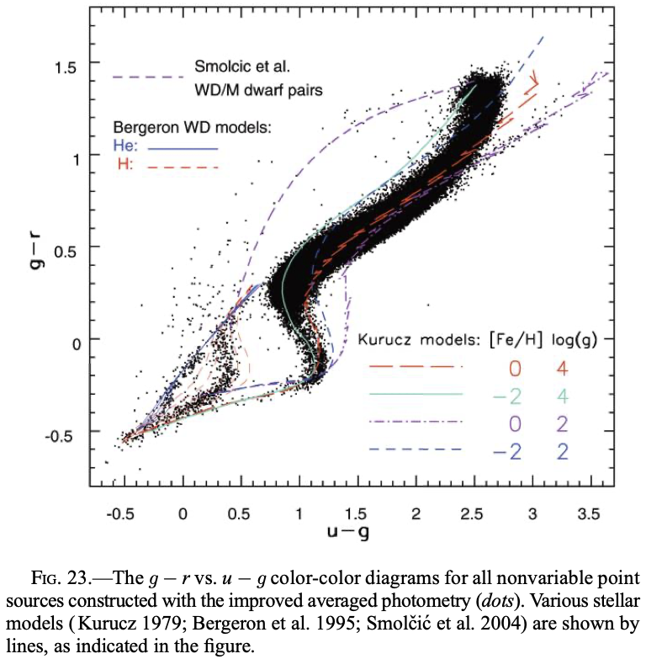
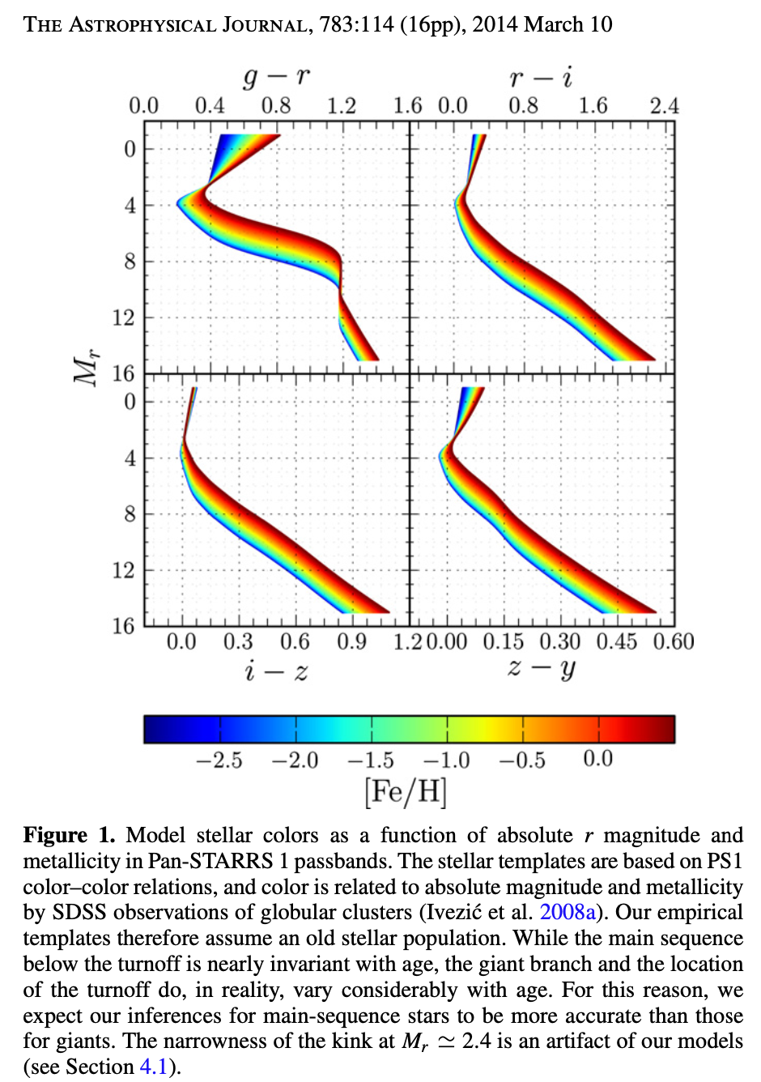
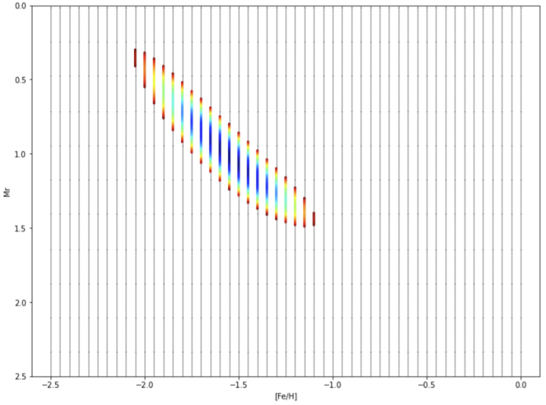
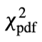
photo-D methodology: stellar astrophysics 1
SDSS color-color diagram (corrected for dust):
- stellar SEDs determined by: T_{eff}, [Fe/H], log(g)
- different populations: MS, giants, WDs, binaries
- for given Mr and [Fe/H] can “predict” colors:
Given observed colors, can estimate Mr and [Fe/H] (and Ar) by chi2 minimization:
Berry+ (2012, ApJ, 757, 166)

Slide 12
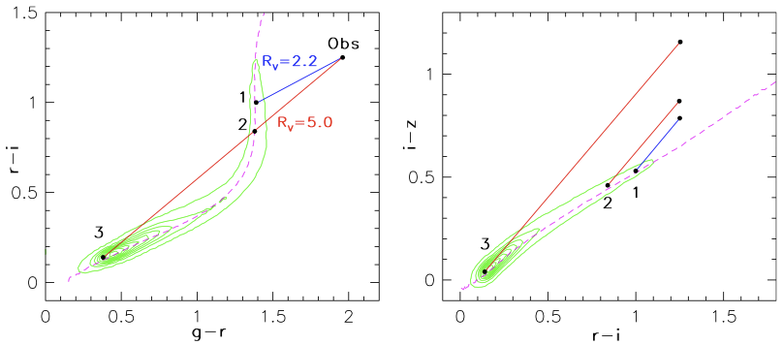
photo-D methodology: stellar astrophysics 2
SDSS color-color diagram (corrected for dust):
- stellar SEDs determined by: T_{eff}, [Fe/H], log(g)
- different populations: MS, giants, WDs, binaries
- assuming pop: from colors get best-fit SED
- best-fit SED gives Luminosity constraint
- pop probability can be gauged from goodness
of fit, variability, priors, and other information
- but there is dust:
Berry+ (2012, ApJ, 757, 166)

Slide 13
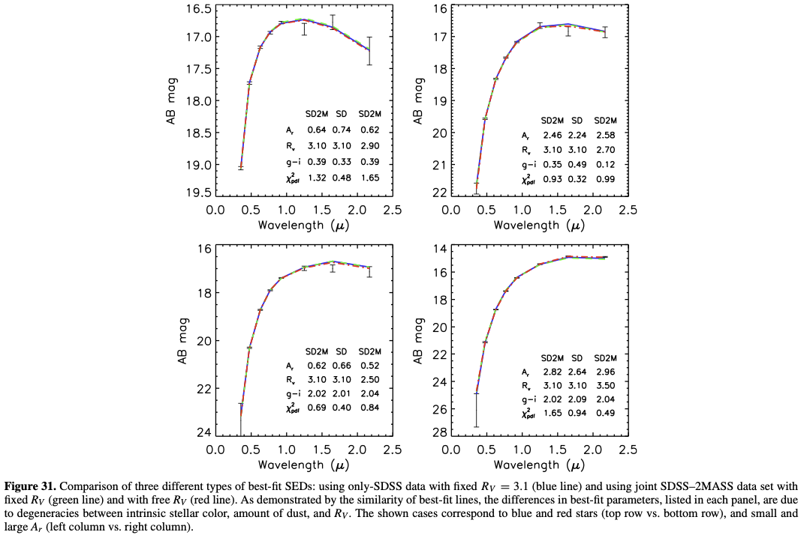
photo-D methodology: impact of dust
There are degeneracies with dust:
- need to adopt an extinction curve
(usually 1-parameter family, R_{V})
Two fitting philosophies:
1) use stellar models to fit SEDs, or
2) use high-latitude observations to fit
dust-extincted low-latitude data
The role of priors...
Hierarchical Bayes...
Robust and fast implementation

Slide 14
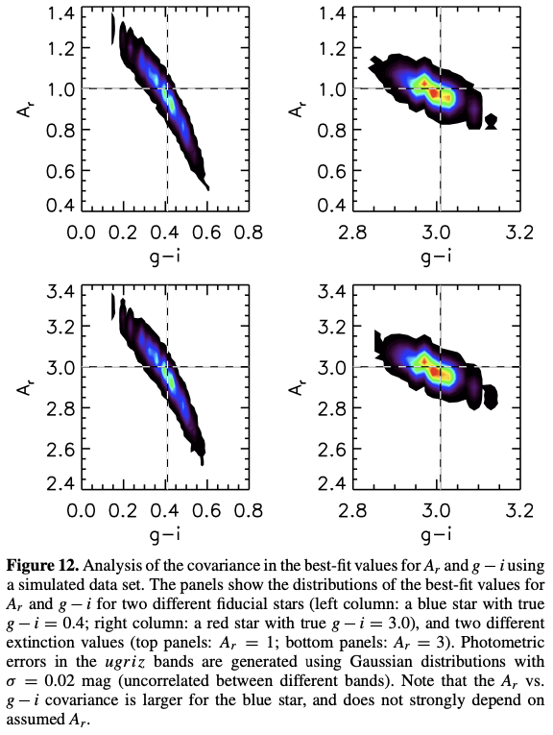
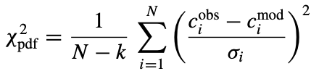
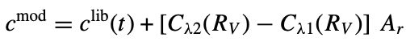
photo-D methodology: statistical treatment
Berry+ (2012): Fit SEDs constructed from high-b observations and a dust model parametrized by R_{V} (shape vs. wavelength) and Av (how much dust) to
SDSS data (very similar to LSST)
2D projections (Ar and “Mr”) of the 3D parameter space (afixed [Fe/H])
Compute best-fit via a brute force χ²-minimization process:
c_{i} and σ_{i} are N adjacent colors and errors (e.g., u - g, g - r, etc
the number of fitting parameters is k = 2 (the position along the locus
and A_{r}) for fixed-R_{V} (R_{V}=3.1), and k = 3 for free-R_{V}
model colors are constructed by:

Slide 15
photo-D methodology: needed improvements
Use of model SEDs or empirical isochrones?
- many pros and cons here...
For a fixed (assumed population), use of priors for fitted parameters
- can rely on TRILEGAL models that are available from NOIRLab’s DataLab, see
https://arxiv.org/abs/2208.00829v1
- what we want to do is nicely described in Green et al. 2014 (ApJ, 783:114)
(but with LSST twice as small distance errors due to u band constraining [Fe/H]!)
Quality assurance using Gaia data products (so-called Bailer-Jones+ distances)
- distances must be consistent with Gaia results
Better code: fast and robust, configuration and metadata management
Documentation!
N.B. There should be many similarities with photo-z frameworks.

Slide 16
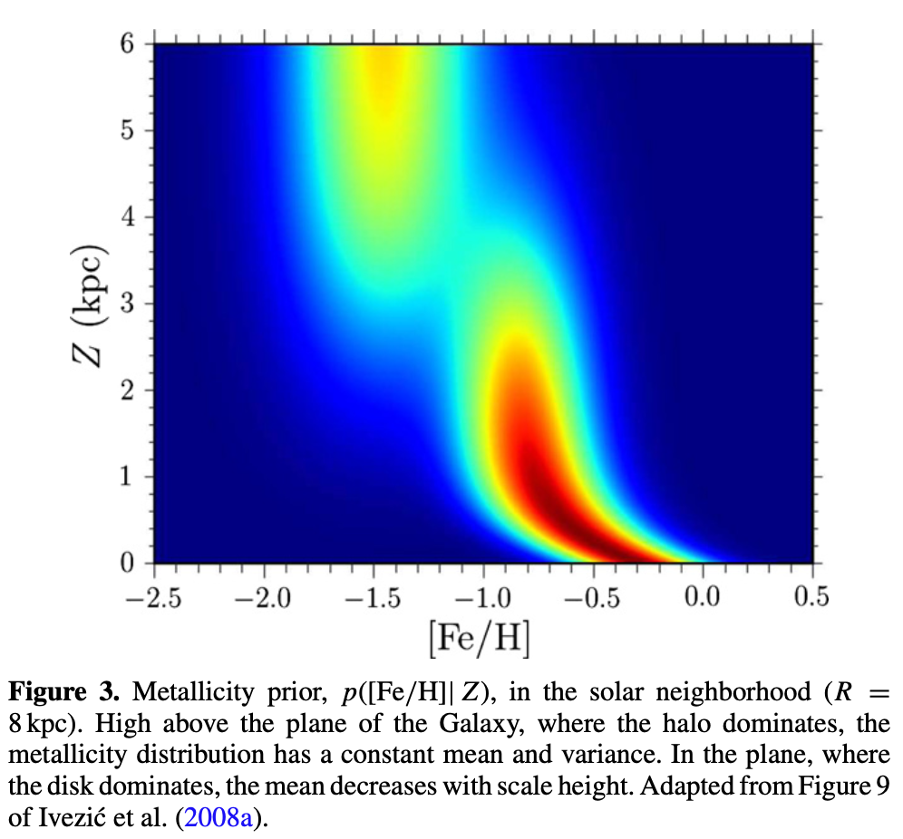
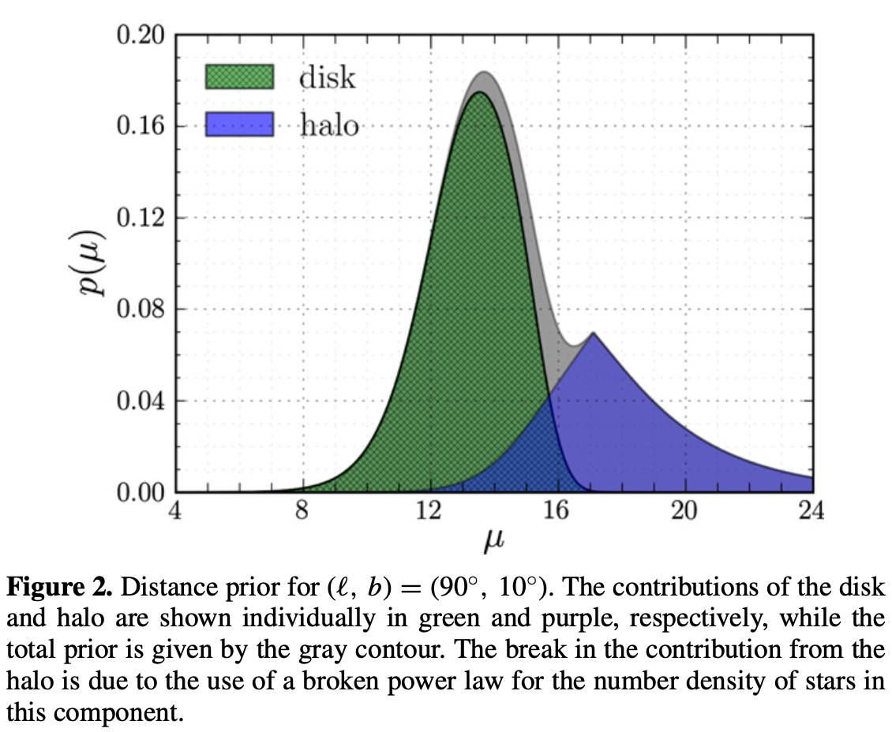
photo-D in Green et al. (2014). “the best paper!”
Left: empirical isochrones (colors on Mr-FeH grid)
Middle: [Fe/H] prior as a function of distance from the Galactic plane (Z)
Right: distance prior

Slide 17
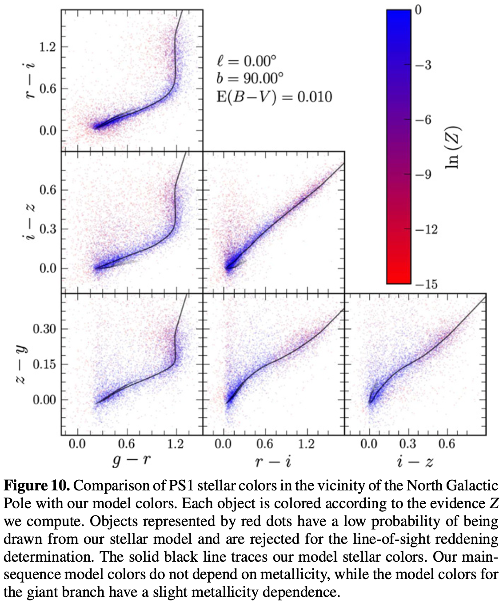
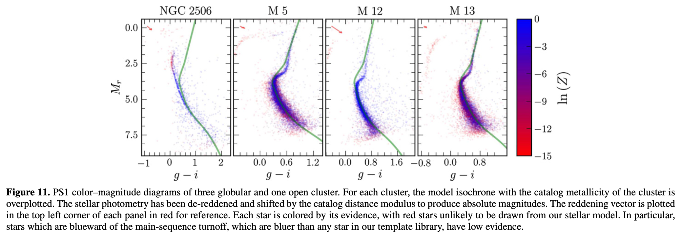
photo-D in Green et al. (2014)
Left: test of isochrones in PS1 color-color diagrams
Below: test using PS1 data for globular clusters, indicates need for isochrone improvements
An advantage of LSST: the u band photometry will provide much stronger constraints for [Fe/H]!

Slide 18
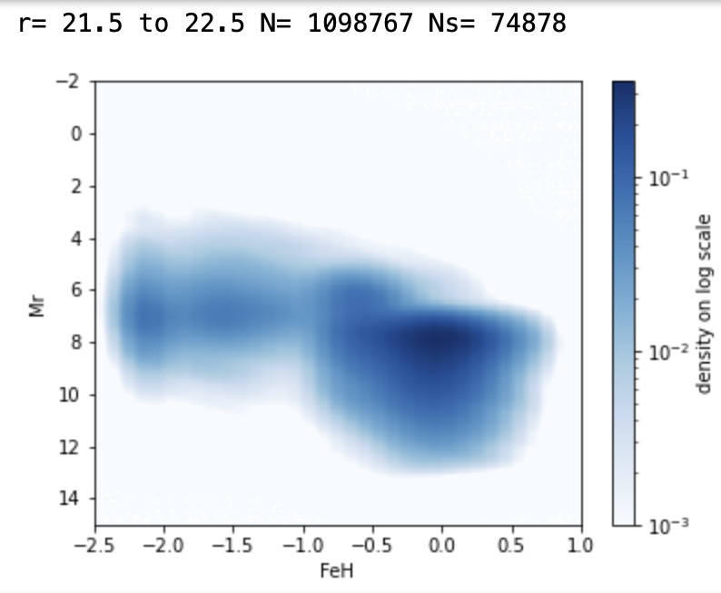
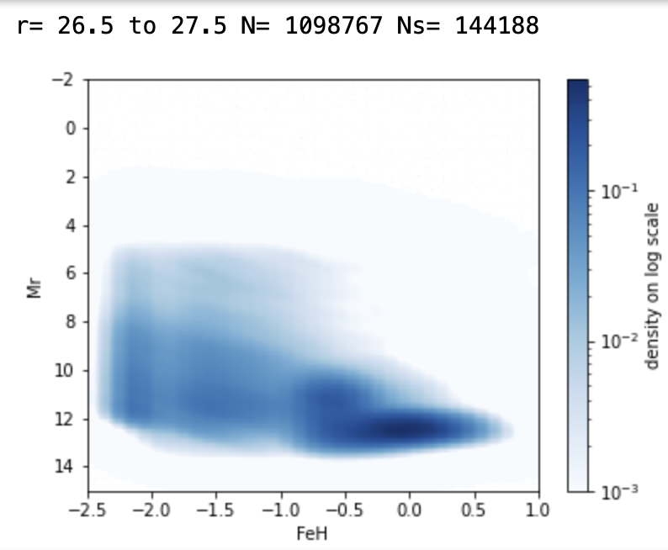
Priors from TRILEGAL (Galaxy simulation code)
TRILEGAL & LSST paper: Dal Tio+ (2022, arXiv:2208.00829)
for now let’s assume distant halo stars with known Ar (dust extinction)
priors in Mr vs. [Fe/H] plane as a function of (R.A., Dec) and r magnitude from TRILEGAL:

Slide 19

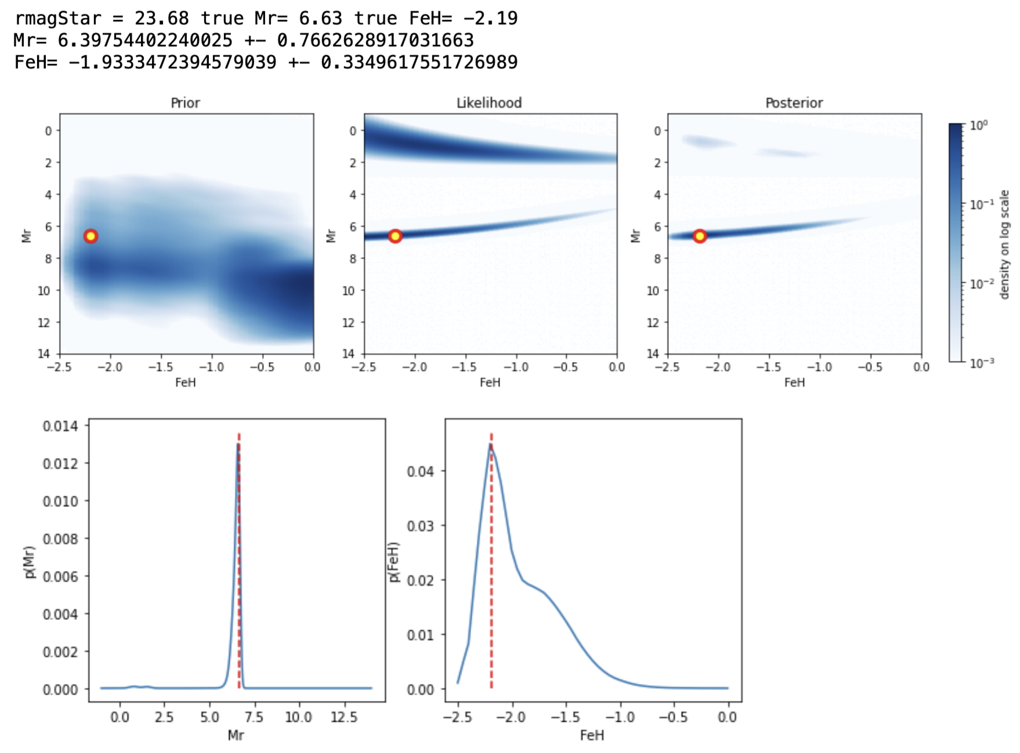
Bayes: posterior likelihood * prior
ALGORITHM:
for given healpixel (from RA, Dec) get TRILEGAL simulated sample
select stars with similar r band magnitudes (~0.5 mag) and construct prior map
with given isochrones, construct likelihood map
multiply likelihood and prior maps to get posterior pdf, and then marginalize to get 1-D posteriors for Mr and [Fe/H]
demonstrably working!

Slide 20
(a lot of) Remaining work...
WORK:
automate the production of maps with priors from TRILEGAL
complete the isochrone library
implement “unknown Ar” use case
develop better code: fast and robust, with configuration and metadata management
test, test, test!
documentation
papers
ALGORITHM:
for given healpixel (from RA, Dec) get TRILEGAL simulated sample
select stars with similar r band magnitudes (~0.5 mag) and construct prior map (Mr – [Fe/H])
with given isochrones, construct likelihood map (Mr – [Fe/H])
multiply likelihood and prior maps to get posterior pdf, and then marginalize to get 1-D posteriors for Mr and [Fe/H]
demonstrably working!

Slide 21
Better code...
CURRENT STATE OF (prototype!) CODE:
a notebook to dump TRILEGAL subsample...
a notebook to compute and store prior maps...
a notebook to produce posteriors...
a lot of hard coded parameters (map properties, grid boundaries, grid steps...) and no configuration and metadata management
only rudimentary testing (no CI, unit tests...)
no documentation (well, here are these slides!)
...but at least it seems fast enough (~20 min on a single core for 1 million stars): ~2 weeks or so for a billion stars / core (need 20-50 cores?)
unclear how to run it and performance on RSP...
ALGORITHM:
for given healpixel (from RA, Dec) get TRILEGAL simulated sample
select stars with similar r band magnitudes (~0.5 mag) and construct prior map
with given isochrones, construct likelihood map
multiply likelihood and prior maps to get posterior pdf, and then marginalize to get 1-D posteriors for Mr and [Fe/H]
demonstrably working!

Slide 22
Plans are nothing but planning is everything...
coarse plans for the next 12+12+12 months for the existing team (dominated by several groups from Croatia plus ZI’s interest plus TRILEGAL connections)
Phase 1: develop methodology, test with SDSS and Gaia
Phase 2: develop robust software framework using TRILEGAL sims
Phase 3: apply to early LSST data (and continue with later DRs)
first papers to write (plus some spin-offs):
- reproducing Gaia distances with SDSS Stripe 82 photometry and statistics (10⁶ stars)
- reproducing distances in TRILEGAL mock catalogs with the chosen method(s)
and production code (10¹⁰ stars)
- construct and publish the first LSST catalog of stellar distances (~end of 2025)
Approximate timelines: paper 1 by the end of ’23, paper 2 by the end of ’24, paper 3 by the end of ‘25. But also additional smaller papers...

Slide 23
SUMMARY
1) To maximize science output with 20 billions stars measured by LSST, we need to estimate their distances: go from 2D to 3D studies.
2) There will be hundreds, if not thousands, of papers enabled by this project/catalog: huge impact.
3) Astrophysics and statistics understood, prototype python code works – the next step is design and implementation of robust and fast code, with proper configuration and provenance management. Interested?

Slide 24
BACKUP SLIDES

